Slide 1
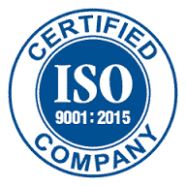
Proalgen Biotech Limited
Nutrapam™ - Natural Mixed Carotenoids (Palm)

Slide 2
Our Company
Proalgen is a company of more than two decades, promoted by technocrat entrepreneurs with a vision to develop innovative products from microbial and plant sources focusing mainly on R&D and Innovation.
We are the first company in India to produce Natural Betacarotene from two sources namely algae and palm. Our established brand name Natrotene® - Natural Betacarotene (Dunaliella Salina) which is a well established and accepted brand all over the world for algal mixed carotenoids and our newly developed palm mixed carotene product Nutrapam™ - Natural Mixed Carotenoids from Palm Source (Elaeis guineensis), is our new innovative product in various formulations.
We aim to provide the natural products to enhance and stimulate the well being of human, animals & in aqua culture nutrition, thereby enhancing their quality of life.

Slide 3
Nutrapam® - Natural Palm Mixed Carotenoids
Nutrapam® is produced from the crude palm oil using a highly innovative proprietary and patented process. The process has been developed by our in-house R & D facility of the company. The process has also brought about a major shift in palm carotenoid extraction process by adopting an unique approach in terms on understanding the methodology involved in production.
Our Palm mixed carotene possesses a mixture of alpha- and betacarotene (which exist in both cis and trans forms), gamma-carotene, lycopene and traces of other minor carotenoids.
An interesting fact of Nutrapam® is that the carotene composition in palm is similar to carrots, with approximately 33 percent alpha-carotene and 65 percent beta-carotene and about two percent of other carotenoids (e.g. γ-carotene, lycopene). Hence, the unique mixture of palm mixed-carotene presents not only a single carotene, but also a wholesome array of carotenoids.
Nutrapam® is commercially available in various forms such as oil concentrate, powder and cold water soluble . Which are widely used as natural colourants for yellow to orange colours in the food and beverage industry in applications such as margarine, cheese, dairy, bakeries, confectionery, dietary supplement, animal feed additives and even cosmetics.

Slide 4
Product List –Nutrapam® - Natural Mixed Carotenoids - Palm
S.No | Product | Oil | Powder
1 | Nutrapam- 2.5%
2 | Nutrapam-5%
3 | Nutrapam-7.5%
4 | Nutrapam-10%
5 | Nutrapam- 20% |  | -
6 | Nutrapam-30% |  | -
Oil Formulation available in (Sunflower Oil, Olive Oil , Sesame Oil, Corn Oil or Rice Bran Oil)
Powder Formulation and 1% ,2.5% CWS formulations

Slide 5
ALPHA-CAROTENE : STRONGER THAN BETA-CAROTENE
Nutrapam™ rich in alpha-carotene, and alpha-carotene often co exists with beta-carotene in fruits and vegetables. Although the vitamin A activity of alpha-carotene is only half of betacarotene, study has shown that alpha-carotene possesses stronger antioxidant efficacy than beta-carotene in phosphatidyl choline vesicles (cellular organelles that transport nutrient into tissues), and thereby minimizing free radical-mediated per oxidative damage against cell membrane in vivo.
When comparing to beta-carotene, research demonstrates that alpha-carotene shows ten times stronger protective effects against certain cancer such as human neuroblastoma cells (ie: a type of cancer that affects early stages of neuronal cells development in infants or young children) in a dose-dependent manner. In addition, alpha-carotene suppresses the initiation of cancer formation in liver, lung and skin more effectively in mice.
However, while alpha-carotene is chemically similar to beta-carotene, several studies seem to demonstrate that alpha-carotene is much more effective in decreasing mortality for certain forms of cancer (lung, prostate, liver, etc.) and reducing the risk of cardiovascular mortality. Research on the subject tends to show that the higher the alpha-carotene blood concentration, the more the risk of all-cause death diminishes.

Slide 6
Nutrapam™- A Unique Mixed Carotene Composition – Naturally
Nutrapam™ – Natural Mixed Carotenoids Palm
α-Carotene
β-Carotene
γ-Carotene
Lycopene
traces of other minor carotenoids
A unique mixture of palm mixed-carotene presents not only a single carotene, but also a wholesome array of carotenoids.

Slide 7
Why Nutrapam™- Natural Palm Mixed Carotene is Superior than other commercially available betacarotene
Commercial Carotene Products | Nutrapam™ - Natural Mixed Carotenoids - Palm | Algae Betacarotene | Fermentative Betacarotene | Synthetic Betacarotene
Source | Crude Palm Oil (Elaeis Guineensis) | Algae - Dunaliella Salina | Fungus - Blackesa Trispora | Petroleum
Composition | 33% alpha carotene 65% beta carotene 2% other Carotenoids like gamma carotene, zeaxanthin & Lutein (mixed carotenoid complex) | >96% Betacarotene (pre dominantly a single betacarotene source) | >98% Betacarotene (pre dominantly a single betacarotene source) | >100% Betacarotene (pre dominantly a single betacarotene source)
Alpha-carotene | Highest level of alpha carotene (33% to 35%) | Negligible level of alpha-carotene | Negligible level of alpha-carotene | No alpha carotene
Cis & Trans isomers | Cis & trans | Cis & trans | 100% trans | 100% trans

Slide 8
Replacing with Nutrapam™ - Natural Mixed Carotenoids (Palm) instead of “Six Southampton Synthetic Colors”.
NUTRAPAM™- NATURAL MIXED CAROTENOIDS E160a(ii)
Tartrazine (E102)
Allura red (E129)
Sunset Yellow (E110)
Ponceau 4R (E124)
Carmoisine (E122)
Quinoline yellow (E104)
Research Shows the side effects of above Synthetic Colors , Please click here : https://www.southampton.ac.uk/psychology/research/impact/food_additives.page

Slide 9
Applications & Uses
FOOD COLORS
Beverages
Jams
Marmalade
Juices
Cakes
Biscuits
Popcorns
Confectionery
DAIRY PRODUCTS
Butter
Margarine
Cheese
Yogurts
Ice Creams
Other Dairy Products
NUTRACEUTICAL
PRODUCTS
Dietary Supplements
Functional Foods
AQUA FEEDS
Fish Feed
Prawn Feeds
Crustacean Feeds
PHARMA PRODUCTS
Soft Gel Capsules
Syrups
Tablets
Etc.,
PET FOODS
Poultry Feed
Cattle Feed
Horse Feed
Large animal feed
Bird Feeds
Small Animal Feed
COSMETICPRODUCTS
Faces wash
Creams
Lotions
Soaps
Sun Screens

Slide 10
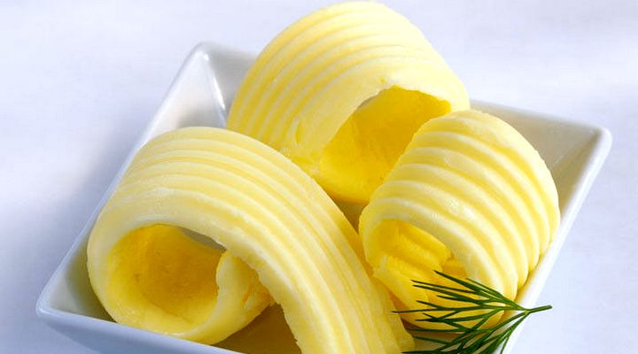
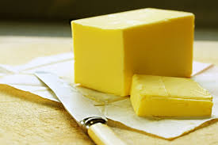
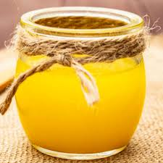
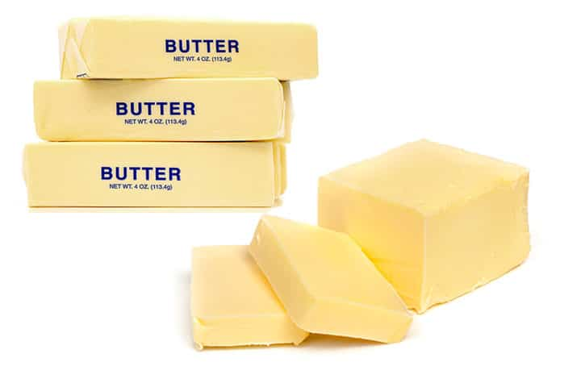
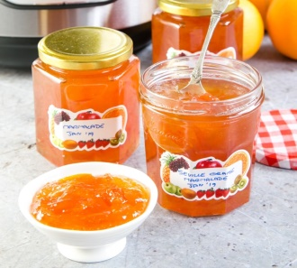
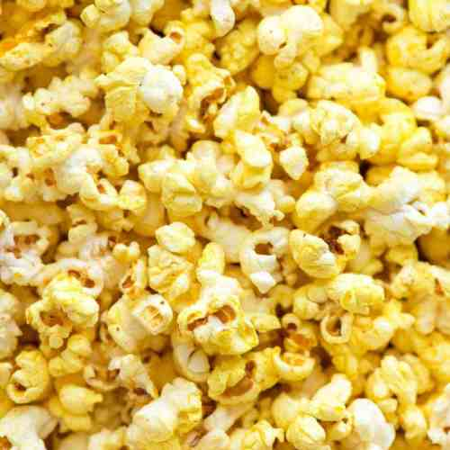
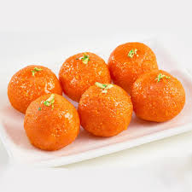
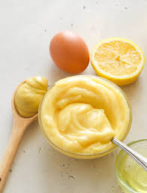
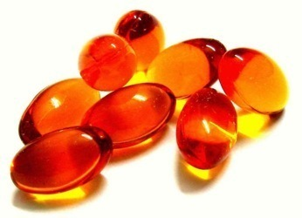
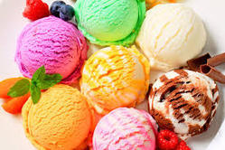
Nutrapam™ for Oil based Formulations for Food
Since our Nutrapam ™ is highly stable in oil based food products and approved food color by FSSAI , European Union , U.S and in many other countries
Oil Based Food Colouring Applications
Margarines/Bakery Fats Cheese Ghee Butter Marmalade
Popcorn
Sweets
Mayonnaise
Nutraceuticals
Ice Creams

Slide 11
FAO/WHO Food Standards & European Union Numbers for Betacarotene
FAO CODEX GENERAL STANDARD FOR FOOD ADDITIVES (GSFA)
INS 160a(i) betacarotene, synthetic
INS 160a(ii) betacarotene, vegetable
INS 160a(iii) betacarotene, blakesla trispora
INS 160a(iv) betacarotene Dunaliella Salina
EUROPEAN UNION FOOD ADDITIVE DATABASE
E160a(i) beta-carotene
E160a(ii) Plant carotenes
E160a(iii) Beta-carotene from Blakeslea trispora
E160a(iv) Algal carotenes

Slide 12
Approved Legal Uses of the Substance:
Meets purity standards listed by the FDA as a GRAS Nutrient/ Dietary Supplement ( 21CFR 184.1245)
Non Certifiable Color Additive in Food Use : (21 CFR 73.95) - FDA
Non Certifiable Color Additive in Drug Use : (21 CFR 73.1095) - FDA
European Union Approved Food Colors E160a(ii) – European Union
GRAS Status of Palm Betacarotene use in food , dietary supplements, animal feeds & cosmetics

Slide 13
Betacarotene uses in food colors & additives
β-Carotene can be used as a color additive (as a food colorant) and/or a nutrient supplement (as a source of vitamin A). Its actions in different applications are as follows:
Use as a food colorant ― Betacarotene preserve, or enhance the color or shading of a food. It is used to add or restore color in a food in order to enhance its visual appeal and to match consumer expectations.
Use as a source of vitamin ― β-carotene is a vitamin A precursor (or called a provitamin A carotenoid4) meaning it can be converted by the body to retinol5 and be subsequently made into retinal and retinoic acid (other forms of vitamin A).
β-Carotene is a direct human food ingredient which functions as a color additive and a nutrient 66 supplement. This substance is used in dairy products, fats and oils, and processed fruits and fruit juices; it may be used in infant formula as a source of vitamin A in accordance with 21 CFR §184.1254.
β-carotene would be used to color food and beverage products including, but not limited to, yogurts, dairy beverages, ice cream, pudding, confectionery, bakery products, and condiments.

Slide 14
Research findings Benefits of Betacarotene in Cow as a feed
Studies have found supplemental beta-carotene to positively effect milk yield. Heat-stressed cows supplemented with 400 mg beta-carotene increased cumulative milk yield by 11% supplemented 300 mg betacarotene and increased milk yield by 6.4% with this difference approaching significance.
With high anti oxidant content betacarotene increases the immunity in cows
Supplemental beta-carotene may enhance rumen function. In vitro growth of rumen bacteria and cellulose digestion have been increased with the addition of beta-carotene in the presence of safflower oil (Hino et al., 1993). Diets designed for high production typically contain significant amounts of lipids that increase the free radical burden in the rumen (Andrews et al., 2006). Other dietary antioxidants have increased fiber digestion when fed with diets containing high levels of unsaturated fat in continuous culture (Vazquez Anon and Jenkins, 2007). Perhaps beta-carotene may perform a positive role as an antioxidant in the rumen.
Reproduction Dietary beta-carotene levels may be linked to fertility as evidenced by higher concentrations of beta-carotene in the ovary, particularly the corpus luteum (Chew et al., 1984). Benefits of supplemental beta-carotene for the dairy cow may be related to the conversion of circulating beta-carotene to vitamin A, specifically in the uterus and ovaries (Schweigert, 2003). Graves-Hoagland et al. (1988) found plasma beta-carotene to be positively related to progesterone production by corpus luteum cells.

Slide 15
Research Studies - Betacarotene Uses & Benefits in Aqua Feeds
Pigmentation is one of the important quality attributes of the fish for consumer acceptability . Betacarotene are responsible for pigmentation of muscles in food fish & skin colour in ornamental fish.
As a fish is not capable of synthesizing carotenoids de novo there is a need to incorporate cartenoids in the diet of cultured species.
Synthetic carotenoids are known to have deteriorating effects on the environment , there is a demand for inclusion of natural carotenoids in aqua feeds to achieve bright coloration in fish.
Fishes with high level of carotenoids are more resistant to bacterial and fungal diseases.
In Prawns, it has the capacity to convert from one carotenoids into another carotenoid i.e., the beta-carotene molecule can be converted into astaxanthin molecule.
Improves growth and survival performance in fish

Slide 16
Thanking You
Corporate Office | Production Facility | Algal Pond Facility
Proalgen Biotech Limited No.8, 6th Cross Street, Karpagam Gardens, Adyar Chennai – 600020, Tamil Nadu , India | NaduvakkaraiVillage, Pattaraikalani PostTirukazhukundrum Taluk, Kancheepuram District -603109 Tamil Nadu India. | Survey No: 121 &255 Kodur Village, Cheyyur Taluk Kancheepuram District – 603305, Tamil Nadu India.
Mr. K.V. Subramanian – GM International – Sales Call or Whatsapp on : +91 9884024207/Email : kvs@proalgen.com Mr. V.S.K. Sridharan – Deputy Manager – Sales & Marketing Call or Whatsapp on :+91 9500017958/Email : sales@proalgen.com

Slide 17
Disclaimer
The information in this presentation was compiled from sources believed to be reliable for informational purposes only. All sample policies and procedures herein should serve as a guideline, which you can use to create your own policies and procedures. We trust that you will customize these samples to reflect your own operations and believe that these samples may serve as a helpful platform for this endeavor. Any and all information contained herein is not intended to constitute legal advice and accordingly, you should consult with your own attorneys when developing programs and policies. You should not take, or refrain from taking action based on its content. We do not guarantee the accuracy of this information or any results and further assume no liability in connection with this publication and sample policies and procedures, including any information, methods or safety suggestions contained herein. Moreover, this presentation cannot be assumed to contain every acceptable safety and compliance procedure or that additional procedures might not be appropriate under the circumstances.

